Slide 1


GROUP 1
MANAGE TIME TO EFFECTIVELY
PRESENTION BY
-VOEUN CHANTHOU
-YOEUN RIN
-KHLORP VEAK
-OUN LATY

Slide 2
TO MANAGE TIME TO EFFECTIVELY
SET SCHEDULE
KNOW WHAT TO FIRST
SET TIME TO DO
AVIOD DOING TOO MANY THING AT ONCE
USE TIME MANAMENT TOOLS
TAKE RESPONSIBILITY FOR YOURSELF
KNOW THE ROLE TO DO
TO BE APPLIED

Slide 3
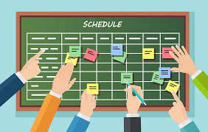
SET THE SCHEDULE
A schedule is plan that gives a list of events or tasks and the times at which each one should happen or be done.

Slide 4

KNOW WHAT TO FIRST
We have a lot of work, We should to divide our work easy to complete it. And than I need to do a important work.

Slide 5

SET TIME TO DO
Know the time to do it. Don't say wait or don't say tomorrow. We should do it at specific time.

Slide 6


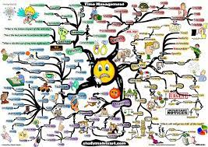
AVIOD DOING TOO MANY THING AT ONCE
When we do a lot of work at once time, We will lost in our works and waste time for to do anything.

Slide 7
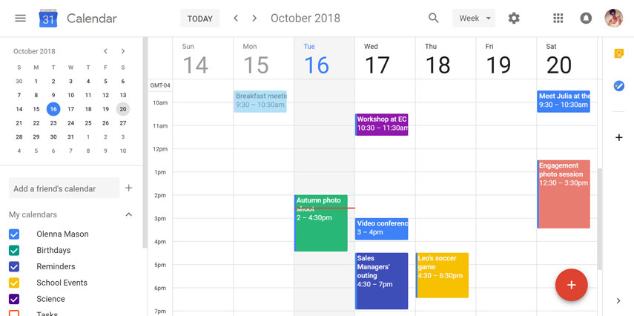
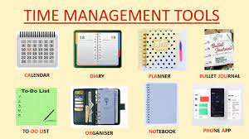
USE TIME MANAMENT TOOLS
Simply said, the point of time management tools is to help you manage your time better. By using time management tools, you can become more productive, make better decisions about your time and reduce the time you spend on things like reporting and invoicing.

Slide 8

TAKE RESPONSIBILITY FOR YOURSELF
Your responsibilities are the duties and obligations you have towards yourself and others. They are the commitments you make to yourself and to others to ensure that you are living a meaningful and fulfilling life

Slide 9


KNOW THE ROLE TO DO
Role is an obligation that we must do on a regular basis.

Slide 10

TO BE APPLIED
the position or purpose that someone or something has in a situation, organization, society, or relationship: What is his role in this project? Schools play an important role in society.

Slide 11

THANK YOU

